Slide 1
EXP3202 is a Psychology Course
  What is Psychology?

Slide 2
100
80
60
Chemical Element No.
40
20
0
R. Buckminster Fuller
0
1K
2K
3K
4K
5K
Recorded History
Key Points
As psychologists, we are trying to understand something that appears to be changing rapidly, with no obvious end in sight. Not true of other sciences. A warning to psychologists who think it is their job to explain the present.
Nothing about the human brain predicted this change, but this change would have been impossible without it. The human brain was a necessary pre-condition.
The science of PSYCHOLOGY sits at the interface between our biology and our experiences – how do nature and nurture make us who we are?

Slide 3
EXP3202 is a Psychology Course
  Why is Sensation and Perception Important for Psychology?

Slide 4

What is real?
We only experience the reality that is created by our brains.
The physical sciences (Physics, Chemistry) have enabled us to ‘see’ the world as it truly exists.
‘Psychophysics’ allows us to establish relationships between our ‘true’ brain-based reality and the ‘true’ physical world.
These relationships are rarely linear (i.e., the brain does not function as a ‘mirror’).
Notes:
wolfe-fig-01-01-0.jpg

Slide 5
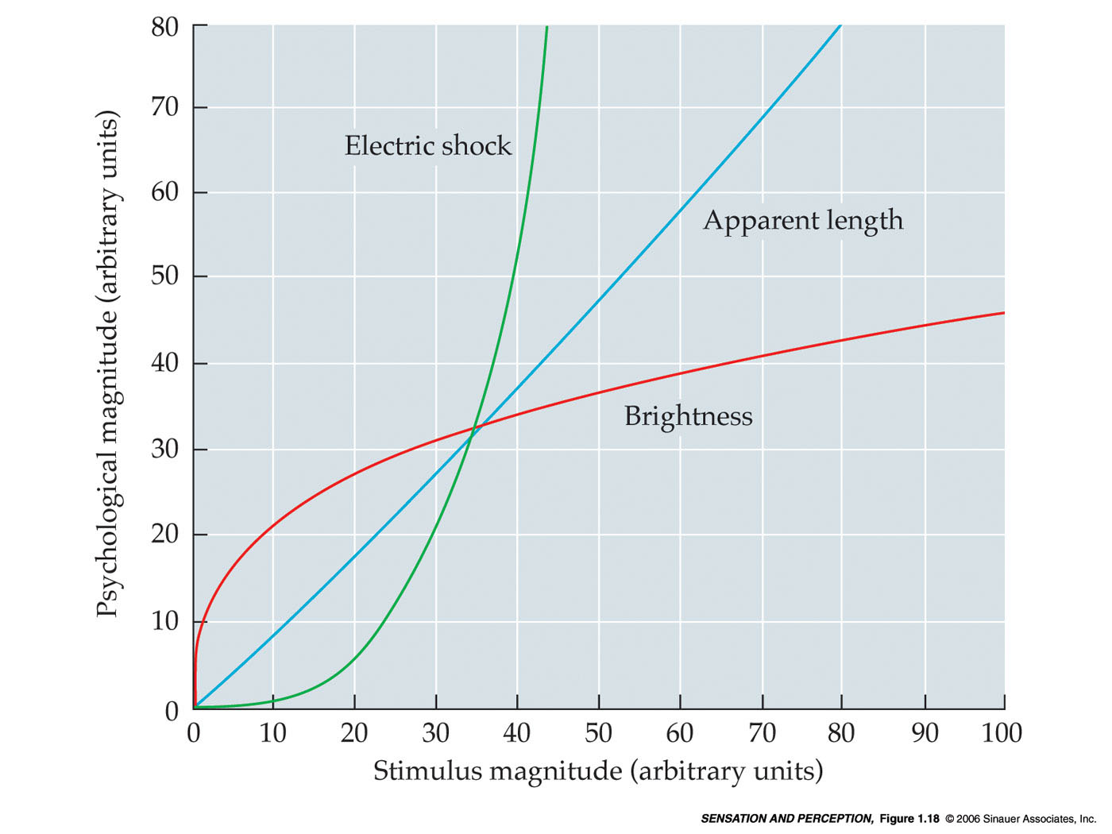
After this course, you can no longer be a ‘naïve realist’
although maybe you didn’t know you were one…
Only in rare instances does
“Psycho = Physics”
Fechner’s Law
S = k log R
“Psycho = log Physics”
Steven’s Power Law
S = a I^{b}
“Psycho = Physics^{b}”
OK, so what does this mean?
It means that our sensory/perceptual systems are often exaggerating small physical differences, or understating large physical differences.

Slide 6
Overview
  The BIG PICTURE

Slide 7

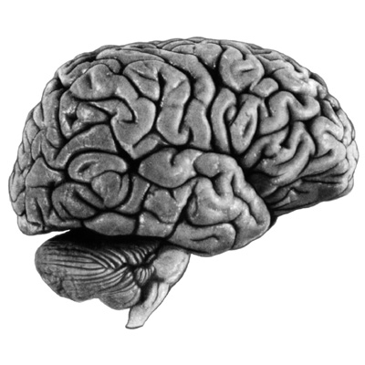
Your World
The Real World
PSYCHO
PHYSICS
Now you’re dreaming. . .
Perception!
(Synthesis)
Sensation
(Analysis)
Colors
Sounds
Tastes
Smells
Pain
Temp
Textures
etc.
Stuff We Can’t Sense…
Wavelength Shape Movement
We only experience the reality that is created by our brains.
Energy
Things vibrating (hearing)
Things bumping into other things (touch)
Matter
Atoms and Molecules (pain, taste, smell)
Photons* (vision)
Wavelength Shape Movement
‘The Matrix’
Receptor Neurons

Slide 8
Your World
The Real World
PSYCHO
PHYSICS
Perception!
(Synthesis)
Sensation
(Analysis)
Stuff We Can’t Sense…
Wavelength Shape Movement
A Drug
Energy
Things vibrating (hearing)
Things bumping into other things (touch)
Matter
Atoms and Molecules (pain, taste, smell)
Photons* (vision)
Wavelength Shape Movement
Receptor Neurons

Slide 9
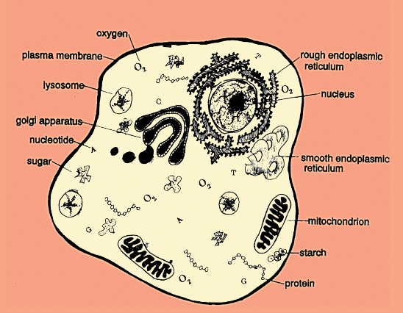
OK – so we are made of cells…
Bags of Water (floating in water) that Consume, Transduce, Store, Expend Energy
Make Proteins (DNA-RNA-Protein)
Make More Cells

Slide 10
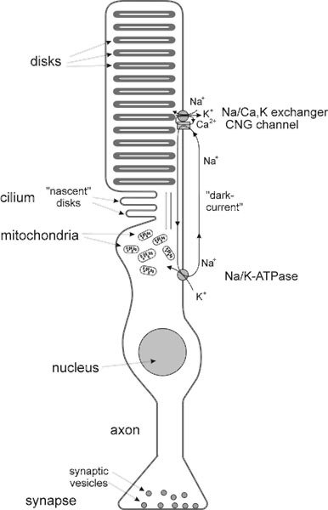
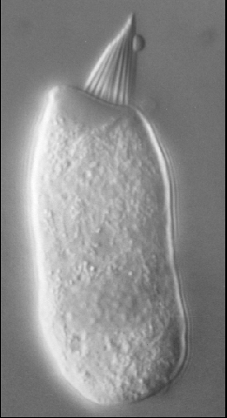
How can we use cells to sense the world?
Neurons: Yes/No/Mo’ Sensory ‘Transducers’
- ‘matter’ and ‘energy’ in the physical world become a pattern of electrical signals
Organize Receptor Neurons as 2D Sheets of Cells
Stimuli Encoded as 2D Maps of Electrical Activity
NOTE: Impossible for Sensory Receptors to Encode 3D, But In Some Cases We Perceive 3D (Vision, Hearing)

Slide 11
LEARN THIS NOW: There are only a few ways to connect neurons. Here are the major ways to do it, with example functions.
1:1 (relay)
Many:1 (gain - sensation,
complexity - perception)
1:Many (arousal)

Slide 12
A 2D Sheet of Sensory Neurons
(Yes/No/Mo’ responses)
A highly simplified, but nevertheless instructive example.
The Stimulus as been ‘broken down’ into a 2D Map of Neural Activity
The ONE stimulus is now the activity of ELEVEN neurons

Slide 13
A 2D Sheet of Sensory Neurons
(Yes/No/Mo’ responses)
To ‘perceive’ the stimulus we simply reverse the process
All ELEVEN neurons connect to ONE neuron

Slide 14
A 2D Sheet of Sensory Neurons
(Yes/No/Mo’ responses)
Stimulus intensity coded by firing rate
Those bright eyes make TWO of the neurons fire at a faster rate

Slide 15
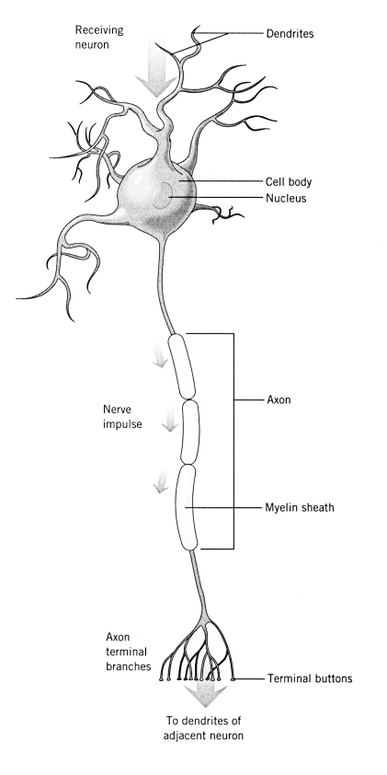
Final Words: Because we’re using ‘dumb’ cells in a complicated world – Division of labor and compromise.
Sensation = Analysis. Perception = Synthesis.
Sensation: Detect or Identify?
Perception: Model or Representation?

